Slide 1
BUBONIC AND CORONA VIRUS PANDEMICS.
STUDY OF HOW THE PAST AFFECTS THE PRESNT

Slide 2
Introduction.
Bubonic plague resulted into death of half the population in Europe.
It was considered as one of fulfillment of vision of apocalypse due to its death effect.
Began from Mongolia empire spreading through sea to Sicily and parts of the world.
Was considered as God’s punishment for the people sins.
Contributed to economic and political revolution.
Notes:
Bubonic plague which is considered to be the cause of the black death began in Mongolia where trade was and wealth had made the empire influential in Asia. Many populations in Europe and America lost their lives, and the futures they were all hoping for were not guaranteed. Violence befell from Italy, England, and china and other parts of the world an agent of death rises that is seen to wipe the entire population.

Slide 3
Social political structure.
Feudalism became very common in the European countries and promoted social stratification.
Empire expansion through conquering other states.
Political collaboration between states, England and an empire in spain through marriage.
Breakdown of church influence in Rome as cases of corruption and immorality risen among the priests.
Civilization in Europe.
Notes:
The politics did not stop controlling the world pattern. The existing conflict between king Edward of England and Phillip of France continued to widen even after the strong England army had defeated the French. Amid these conditions, the reality of God's intention to wipe the entire population was evident. Before the plague, there were changes in the climate patterns as temperatures increased unusually, probably due to the increased industrialization in almost all of Europe's trends that emitted gases polluting the environment. Trade improved, leading to social stratification, with wealthy merchants and royal families seeming to be masters upon the poor class.

Slide 4
Economic structure.
Industrialization promoting change in climate patterns and famine.
Increased participation in trade among many countries including Mongolia trading with other nations in Europe.
Decrease in labor value due to feudalism and control of the rich upon poor.
Economic prosperity was the trend before the outbreak of the virus.
Globalization has facilitated spread of corona virus today.
Environmental pollution due to poor disposal of carcinogens and other disease causing agents.
Notes:
Crops failed due to these conditions, and famine followed, golden ages seems to collapse as nations kept to rise against each other. . The growth of industries was added to many factors, including the cheap labor the nations obtained from slaves they got from Africa and their colonies. . The black death began in Mongolia, and in a way n which it spread remains a mystery, the plague reached Europe and other parts of the world. Religion becomes the resort during this crisis.

Slide 5
Globalization and sustainability of life.
Technology poses a threat to the environment, through radioactivity exposing organisms to mutation.
Trade and commerce has increased human contact that has enabled easy spread of the corona virus.
Capitalism has promoted rise of drug monopolies and companies exposing humans to carcinogens in their waste disposal.
Economic war and exhaustion of resources have reduced ability of poor countries to withstand global pandemics.
Genetically modified organism continues to pose risk to both animal and plants life.
Notes:
The capitalist globalization is not biologically sustainable because of the globalization way of life that has made the environment prone to pandemics. It has led to wealth accumulation by system individuals regardless of the wellness of other populations, the environment, or animals living. It has led to drug monopolies that would not mind investing wealth gains at the expense of life other humans.

Slide 6
Mongol empire and its impact in Europe.
Mongolia had extended its empire in Asia and continued to dominate by conquering other nations.
Mongolia was leading participant in trade, decided to conquer neighbors to take control of all trade routes.
Bubonic virus impact began in Mongolia, to Sicily through ships in the sea that were used in trade to Europe.
Corona virus originated in Wuhan, city in china and then spread to other parts of the world.
Movement of goods and services through trade just like in 1400 facilitates spread of this virus, this time faster due to modern technology,
Notes:
The plague originated from Mongolia, an empire whose dominance in Asia had grown at a very high rate. Ambitions and nationalism led them to conquer more and cities so that they could control the most significant part of the trade routes. The plague of coronavirus has spread due to the globalization that facilitated the movement of the virus from Wuhan China to other parts of the world. With modern technology today it will be even easier for the virus to spread across the world.

Slide 7
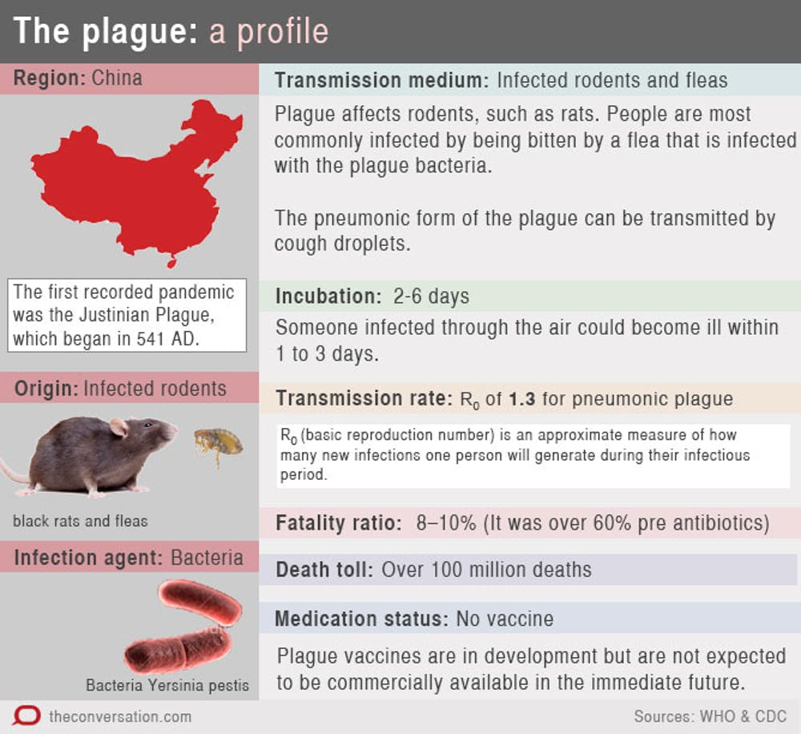
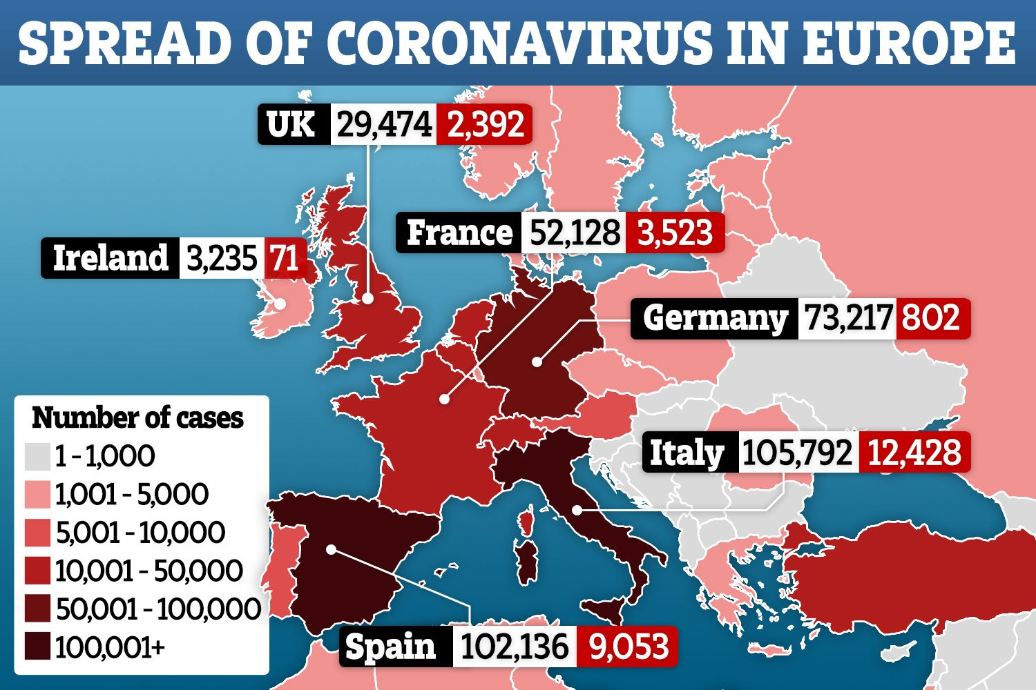
Spread of bubonic virus and corona virus.

Slide 8
References.
https://www.thesun.co.uk/wp-content/uploads/2020/04/ac-graphic-map-coronavirus-spread-in-europe-1-APRIL-1730.jpg
https://mronline.org/2020/04/07/mike-davis-on-pandemics-super-capitalism-and-the-struggles-of-tomorrow/
https://portside.org/2020-04-12/scholar-pandemics-and-inequality-peers-americas-future
https://youtu.be/Yb1CcvqJ0gc
https://youtu.be/q1-xhoJQLHU

